Slide 1
Bennett Elementary VGA analysis
Logan Brady

Slide 2
Agenda
Introduction
Timeline
Results
Questions

Slide 3
Introduction
Virginia Growth Assessments (VGAs):
  Bi-annual standardized examinations.
  Designed to rate progress in mathematics and reading.
Full data analysis and visualization:
  To determine trends in raw data to aid in educational/administrative decision making.

Slide 4
Original Timeline
5 stages spanning the course of 3 weeks.
Client Analysis (1 day)
Data Acquisition (1 day)
Data Cleaning (2-4 days)
Exploratory Analysis (5-7 days)
Data Visualization (7-10 days)

Slide 5
Actual Timeline
9 stages spanning the course of about 5 weeks.
Client Analysis (1 day) Week 1
Data Acquisition (1 day) Week 1
Data Cleaning (5 days) Week 1 & 2
Exploratory Analysis (5 days) Week 2 & 3
Data Acquisition (1 day) Week 3
Data Cleaning (3 days) Week 3
Exploratory Analysis (7 days) Week 4
Data Visualization (3 days) Week 4 & 5

Slide 6

Results

Slide 7
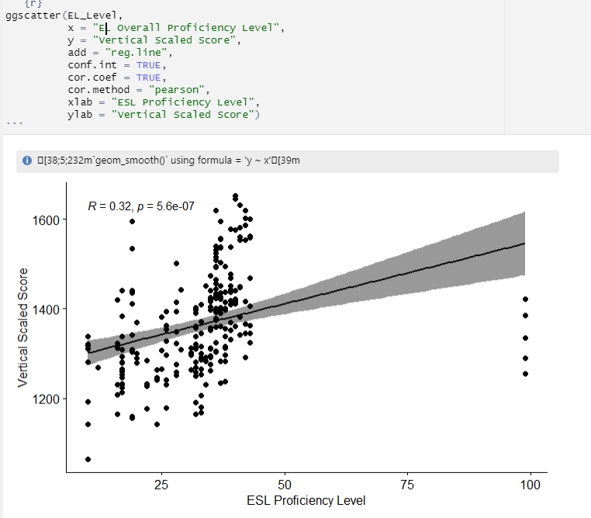
ESL Correlation model
Shows a moderate positive correlation between ESL Proficiency level and vertical scaled score.
Meaning, the higher a student’s proficiency is in English, the higher they’ll score on their test.

Slide 8
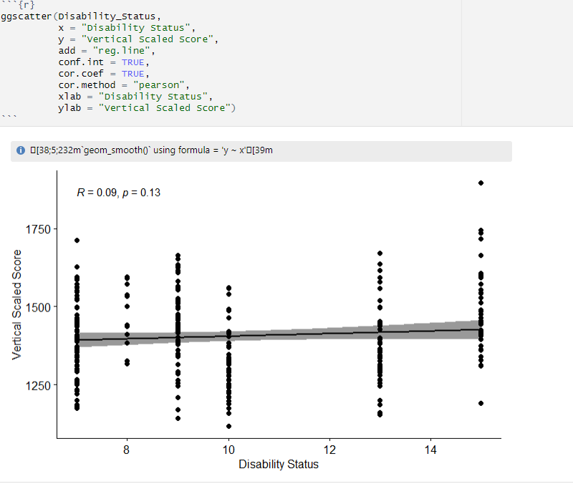
Disability Status Correlation model
Shows a small positive correlation between Disability Status and vertical scaled score.
Not a strong correlation with this model, but can be explored with other models…

Slide 9
VGA Dashboard

Slide 10
Questions?

